Slide 1
Can You Read a Picture Book Without the Words?
An Activity Based on
Gopher To the Rescue! A Volcano Recovery Story

Slide 2
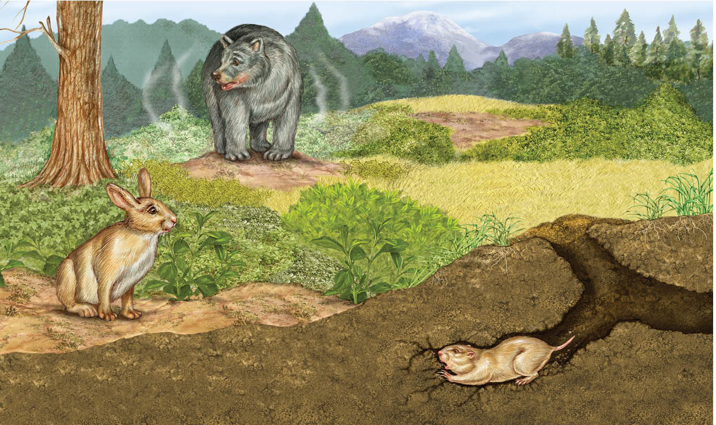

Slide 3
